Slide 1
Summary
Tianzhu Wei
2017 -1-1
Notes:
香港中文大学
新加坡南洋理工大学

Slide 2

1. Truss decomposition in massive networks (VLDB-2012 )

Slide 3

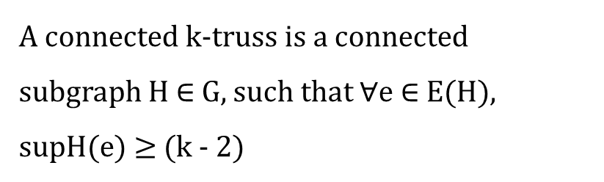

Problem definition
t
The support of an edge e(u , v) ∈ G
v2
v5
p1
$$\sup_{G}(e)$$
$$=|\left\{△_{uvw}:w∈V\right\}|$$
P2
q1
v1
v3
Conneceted K-Truss
A connected k-truss is a connected subgraph H $∈$ G, such that $∀$e $∈$ E(H), supH(e) $≥$ (k - 2)
q2
v4
P3
4 - Truss

Slide 4


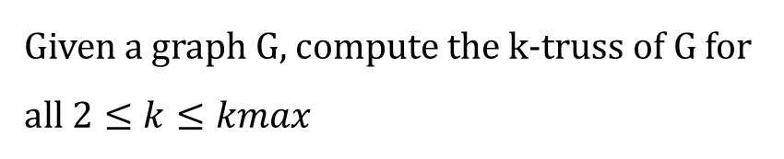

Problem definition
t
$$\text{The} \text{trussness} \text{of} \text{a} edge$$
v2
v5
p1
$$τ\left(e\right)=\max_{H⊆G\&e∈E\left(H\right)}\{τ\left(H\right)\}$$
$$τ\left(e\right)=4$$
P2
q1
v1
v3
q3
Truss Decomposition
Given a graph G, compute the k-truss of G for
all $2≤k≤kmax$
q2
v4
P3

Slide 5








Exist Solution
In-Memory Algorithm
a
e
f
j
$$compute support\left(e\right)$$
3
1
2
3
2
2
2
$$support\left(e\left(a,b\right)\right)=| nb\left(a\right)⋂nb\left(b\right) |$$
=3
3
3
4
2
2
3
d
1
g
0
3
3
2
$$nb\left(a\right)=\{e,d,b,c\}$$
1
2
i
b
h
3
0
$$nb\left(b\right)=\{a,e,d,c\}$$
3
1
1
0
1
1
0
$$Remove edge$$
c
L
k
$$remove e :\sup\left(e\right)<(k−2)$$
using a queue
3-Truss
$$k=3$$
$$k=4$$

Slide 6

Exist Solution
In-Memory Algorithm
a
e
f
j
$$compute support\left(e\right)$$
3
2
3
2
2
$$support\left(e\left(a,b\right)\right)=| nb\left(a\right)⋂nb\left(b\right) |$$
=3
3
3
3
2
2
d
$$nb\left(a\right)=\{e,d,b,c\}$$
3
3
i
b
h
2
$$nb\left(b\right)=\{a,e,d,c\}$$
3
3
$$Remove edge$$
c
$$remove e :\sup\left(e\right)<(k−2)$$
4-Truss
$$k=3$$
$$k=4$$
$$k=…$$

Slide 7






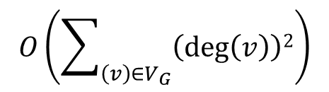
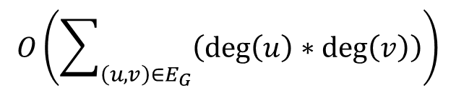
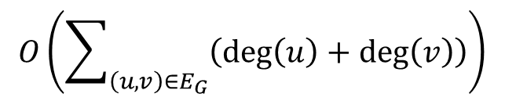

Exist Solution
In-Memory Algorithm
a
e
f
j
$$compute support\left(e\right)$$
$$support\left(e\left(a,b\right)\right)=| nb\left(a\right)⋂nb\left(b\right) |$$
d
g
$$O\left(\sum_{\left(u,v\right)∈E_{G}}{\left(\deg\left(u\right)∗\deg\left(v\right)\right)}\right)$$
b
i
h
$$Remove edge$$
$$Updating the adjacency lists u and v$$
c
L
k
$$for each dege e(u,v)$$
$$O(\deg\left(u\right)+deg⁡(v))$$
$$O\left(\sum_{\left(u,v\right)∈E_{G}}{\left(\deg\left(u\right)+\deg\left(v\right)\right)}\right)$$
$$O\left(\sum_{\left(v\right)∈V_{G}}{\left(\deg\left(v\right)\right)2}\right)$$
$$for all deges e(u,v)$$

Slide 8
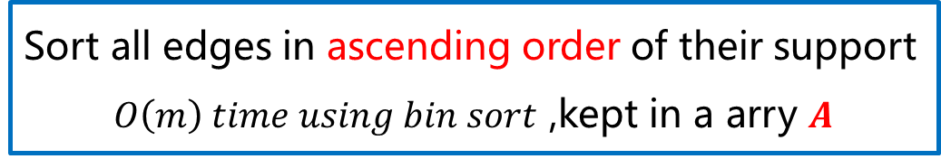

OurSolution
An Improved Algorithm
Comupte the support for edges in G
$$O(m^{1.5})$$
Sort all edges in ascending order of their support
$O\left(m\right) time using bin sort$ ,kept in a arry $Α$
Remove edges
But not explicitly remove

Slide 9











OurSolution
An Improved Algorithm
a
e
f
j
3
1
2
$$remove e :\sup\left(e\right)≤(k−2)$$
k=2
3
2
2
2
3
3
4
2
2
3
d
g
2
$$Φ_{2}=\{(k,i)\}$$
3
3
1
1
2
i
b
h
k-class
$$\deg\left(k\right)=3$$
k=3
$$<$$
$$\deg\left(d\right)=7$$
3
1
3
1
0
$$define as \{e : ∈E_{G} , φ\left(e\right)=k\}$$
1
1
0
$$\operatorname{nb}\left(k\right)=\{d,g,i\}$$
c
L
k
Efficient ?
$$if (d,w)∈E_{G}{ (w∈nb(k))}$$
not explicitly remove
$$\sup\left(d,g\right)←(\sup\left(d,g\right)−1)$$
Reorder
$$\sup\left(k,g\right)←(\sup\left(k,g\right)−1)$$
A
$$(i,k)$$ | $$(d,k)$$ | $$(k,g)$$ | ... | $$(d,g)$$ | ... | $$(a,c)$$ | $$(e,d)$$
$$Φ_{3}=\{(d,k)\}$$
Notes:
K-class 就是指 所指边最大的 trussness

Slide 10


OurSolution
An Improved Algorithm
$$if (d,w)∈E_{G}{ (w∈nb(k))}$$
Reorder
Bin
0 | $$1$$ | $$2$$ | 3 | 4
A
$$\left(i,k\right)0$$ | $$\left(d,k\right)1$$ | $(k,g)$1 | ... | $$\left(d,g\right)2$$ | ... | $(a,c)$3 | $$\left(e,d\right)4$$
Hashtable
$$(i,k)$$ | $$(d,k)$$ | $$(k,g)$$ | ... | $$(d,g)$$ | ... | $$(a,c)$$ | $$(e,d)$$

Slide 11
OurSolution
用于处理大图的，跟之后论文关系不是很大，不准备详细讲
Bottom-up truss decomposition
Top-down truss decomposition

Slide 12
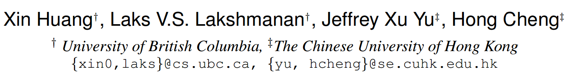
6. Approximate Closest Community Search in Networks (VLDB-2016)
Notes:
香港中文大学
新加坡南洋理工大学

Slide 13
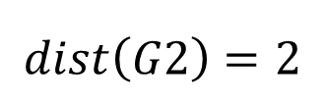
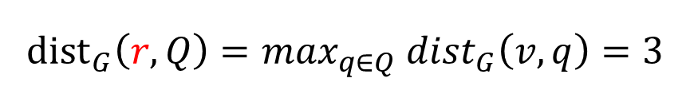
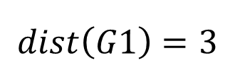
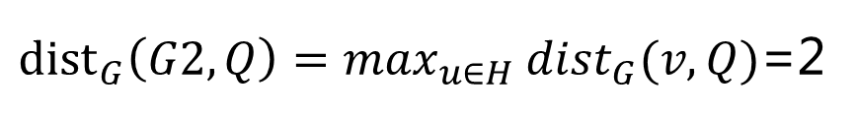
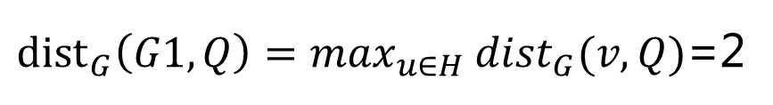
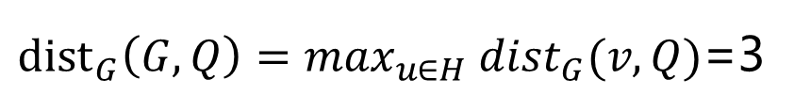
Problem definition
Free Rider Effect
Query Distance
q1
p
$${dist}_{G}\left(r,Q\right)=\max_{q∈Q}{ dist}_{G}\left(v,q\right)=3$$
r
${dist}_{G}\left(G,Q\right)=\max_{u∈H}{ dist}_{G}(v,Q)$=3
v
${dist}_{G}\left(G1,Q\right)=\max_{u∈H}{ dist}_{G}(v,Q)$=2
q2
G2 4-Truss
${dist}_{G}\left(G2,Q\right)=\max_{u∈H}{ dist}_{G}(v,Q)$=2
G1 4-Truss
Graph Diameter
$$dist\left(G1\right)=3$$
$$dist\left(G2\right)=2$$
Notes:
G G1 G2 都满足 4-truss 且包含查询结点集合 Q

Slide 14
t
Connected k-Truss
v2
v5
p1
2) Smallest Diameter
P2
q1
v1
v3
q3
q2
v4
P3
4-Truss
CTC-Problem : Given a graph $G(V,E)$ and a set of query vertices $Q=\{v_{1},…,v_{r}\}$ , find a closest truss community containing Q .

Slide 15
Our solution
Basic Algorithmic Framework
t
1) Finding G0
v2
v5
p1
2) Remove nodes far away from the query nodes
P2
q1
v1
v3
q3
3) Maintenance
q2
v4
P3
4-Truss
Notes:
G0 需要满足包含所有的查询结点的同时保证 K-Truss最大
先找到 G0（满足查询结点中的最大 K-truss）
G0 可能有一个非常大的 图直径，所以我们需要找到一些点将这些“搭便车”的点删除
删除这些点之后可能使我们之前找到的子图不在满足 K-kruss 图的性质，这个时候我们就要进行维护了。

Slide 16

Our solution
K-truss Identification
t
The old
0
0
v2
v5
p1
2
k = 3
k = 4
k = 5
3
3
P2
$$\sup_{G}\left(e\right)<k−2$$
q1
v1
v3
q3
q2
v4
P3
Notes:
之前找G0 是利用图分解的方法来进行的
计算出每条边的 support 值
让 K=3 开始进行循环，将support 值小于（k-2）的边删除，因为删除一条边可能对其它边的 support 值影响，所以我们要将可能影响的值进行一下更新

Slide 17
Our solution
Truss Index
v2
v3
q1
q2
t1
***
v4
…………
4
4
4
4
4
4
4
2
4
q1
q2
$$τ(t1,v2)$$ | $$τ(t1,q1)$$ | $$τ(t1,v1)$$ | $$τ(t1,t2)$$
t1
t2
4
4
4
4
v1
v4

Slide 18
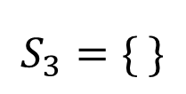

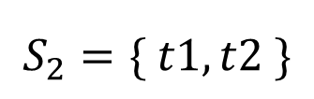
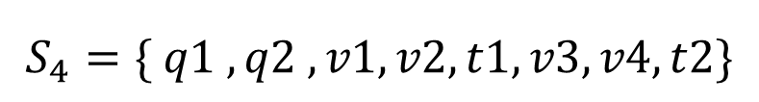
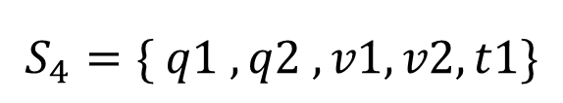
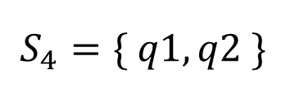
v2
v3
Our solution
Finding G0
4
4
4
4
4
4
4
2
4
$$τ\left(q1\right)=τ\left(q2\right)=4$$
k = 4
q1
q2
t1
t2
4
4
4
4
$$S_{4}=\{ q1 , q2 , v1,v2,t1\}$$
$$S_{4}=\{ q1,q2 \}$$
$$S_{4}=\{ q1 , q2 , v1,v2,t1,v3,v4,t2\}$$
v1
v4
$$S_{2}=\{ t1,t2 \}$$
v2
v3
k = 3
$$S_{3}=\{ \}$$
q1
k = 2
q2
t1
t2
v1
v4
G0
Notes:
G0 用查询的结点进行初始化 G0=｛ q1 q2 ｝
把与 q1 q2 相连接的边的结点 Truss值为4的加入到S4集合中
当处理到 边（t1,t2）时将这两个点加入到 S2集合｛t1 t2｝
当处理完 S4 集合后，接着处理 S3（为空） S2（不为空重复上述过程）此时查询结点连通了

Slide 19

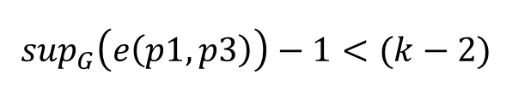
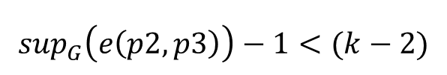
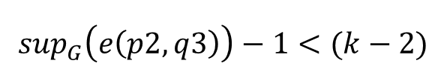
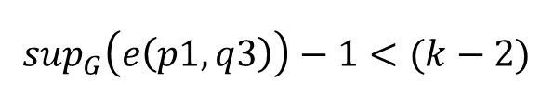
Our solution
K-Truss Maintance
t
Remove p1
0
0
v2
v5
p1
$$S=\{\left(p1,q3\right),\left(p1,p3\right),\left(p1,p2\right)\}$$
2
3
3
Delete (p1,p2)
P2
q1
v1
v3
q3
$$\sup_{G}\left(e\left(p1,q3\right)\right)−1<(k−2)$$
q2
v4
P3
$$\sup_{G}\left(e\left(p2,q3\right)\right)−1<(k−2)$$
Add to S
delete e(p1,p2)
$$\sup_{G}\left(e\left(p2,p3\right)\right)−1<(k−2)$$
$$\sup_{G}\left(e\left(p1,p3\right)\right)−1<(k−2)$$
If delete q3 can not contain all query nodes
Notes:
p1结点为距离查询结点最远的点

Slide 20

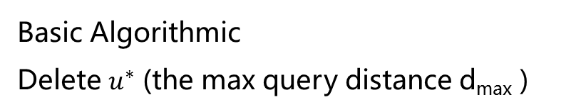
Our solution
Bulk Deletion Optimization
Basic Algorithmic
Delete $u^{∗}$ (the max query distance d_{max} )
$$L=\{u^{∗}|{dist}_{Gi}\left(u^{∗},Q\right)≥dmax−1,u^{∗}∈G_{i}\}$$
$$L=\{q1,q3,p1,p2,p3\}$$
Removing L from G0
The remaining graph does not contain Q
The approximation quality is low
Notes:
删除的时候我们不再每次只是删除一个点
而是删除至少 k 个点
查询距离为 d 的最少表一个点，
查询距离为 （d-1） 至少有 （ k-1 ）个
这里面感觉作者纯粹的是为了提高查找速度而特意增加了一次删除的结点的个数，很显然准确率是下来了

Slide 21
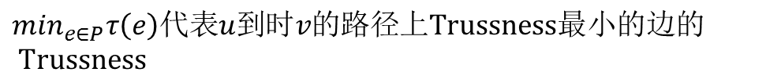

Our solution
Local Exploration
t
2
2
Form a Steiner Tree T to connect
all query nodes
v2
v5
p1
4
Expand T to get a G0
4
4
P2
Find the higest k containing Q
q1
v1
v3
q3
The smallest trussness of the edge is 2
q2
v4
P3
The smallest trussness of the edge is 4
$$\hat{dist}\left(u,v\right)=dist\left(u,v\right)+γ(\overline{τ}\left(φ\right)−\min_{e∈P}τ(e))$$
$\overline{τ}\left(φ\right)$ is the maxmum trussness of any edge in G
$$\min_{e∈P}τ\left(e\right)代表u到时v的路径上Trussness最小的边的 Trussness$$
Notes:
$$γ越大表示边的 truss 值起的作用就越大$$

Slide 22




Our solution
t
2
2
Expand T to get a G0
v2
v5
p1
$$k_{t}=\min_{e∈T}τ\left(e\right)=4$$
4
$$τ\left(e\right)≥k_{t} add to Gt$$
4
4
P2
$${|G}_{t}|≤η$$
q1
v1
v3
q3
Apply a truss decomposition algorithm on G_{t}
extract the maximal connected k-truss subgraph Ht
q2
v4
P3
Bulk Delete
$$L=\{u^{∗}|{dist}_{Gi}\left(u^{∗},Q\right)≥d−1,u^{∗}∈G_{i}\}$$
$$L′=\{u^{∗}|{dist}_{Gi}\left(u^{∗},Q\right)≥d,u^{∗}∈G_{i}\}$$

Slide 23
作者提出的 LCTC 原始方法：
生成 Steiner 树 T (假设我们已经找到了一个符合要求的 Steiner 树
将由 1 得到的 T 进行扩展操作得到GT（通过 T 内的结点来进行拓展）添加边来进行
t
2
2
v2
v5
p1
4
4
4
P2
q1
v1
v3
q3
q2
v4
P3

Slide 24
改进 LCTC 方法：
生成 Steiner 树 T (假设我们已经找到了一个符合要求的 Steiner 树(同原方法)
将由 1 得到的 T 进行扩展操作得到GT（通过 T 内的结点来进行拓展）添加点构成三角形
t
2
2
v2
v5
p1
4
4
4
P2
q1
v1
v3
q3
q2
v4
P3

Slide 25


作者方法使用索引结构
改进方法使用索引结构
q1
q2
t1
***
v4
v1,v2
v2,v3
u,v
***
vm,vn
…………
…………
$$τ(t1,v2)$$ | $$τ(t1,q1)$$ | $$τ(t1,v1)$$ | $$τ(t1,t2)$$
$$τ(v1)$$ | $$τ(v2)$$ | $$τ(v2)$$ | $$τ(v3)$$
我们的关键字存储的是边
对应的 value 值我们存储的是点，这个可以与边的两个点构成三角形，且是按点的 Truss值由大到小来进行存储的
我们的关键字存储的是顶点
对应的 value 值我们存储的是从这个点出去的边，且是按照边的 Truss 值由大到小进行排列的
平均下来我们这样做索引结构可能占用更多的内存
设有 V 个结点 E条边
原始索引占用空间：V+2E
新的索引占用空间：2E+TE ( T 为平均每条边的support 值)

Slide 26
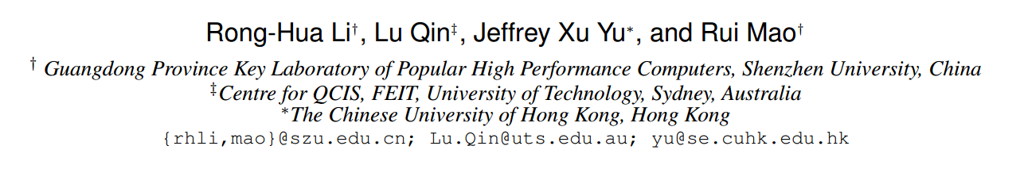
4. Efficient and Progressive Group Steiner Tree Search (SIGMOD-2016)

Slide 27
The GST Problem
Group Steiner Tree
1
1
Given a weighted and labelled ( S ) graph G ;
A subset of labels P ( P ⊆ S ) ;
4
4
4
4
4
4
1
1
1
1
Find the minimum weight connected tree from G that includes all the labels in P
v1
v2
v3
v4
Notes:
边加权 ST 问题
每一个结点都有含有多个标签
给定一个查询标签集合P

Slide 28
Exist Solution
The parameterized DP algorithm
v
T(v,X)
The optimal weight of the state (v , X ) could be obtained by :
u
T(u,X)
a ) Edge growing operation
V
T(v,X)
X
b ) Tree merging operation
X
X = X₁ ∪ X₂
(X₁ ∩ X₂=NULL)
T(v,X₁)
v
v
T(v,X₂)
X₁
X₂
Notes:
state (v , X ) 表示以 v 为根，含有标签集合 X 的树

Slide 29
v7
Exist Solution
The parameterized DP algorithm
4
v5
v7
v5
v5
v6
v6
v7
v7
v8
v8
v5
Priority Queue
1
1
1
1
4
4
4
4
1
v1
v2
v3
1
4
1
1
v9
v4
v1
v1
v1
v2
v3
v4
v1
v2
v3
v4
v1
a) maintain the states (e.g., (v , X ))
b) the weight of a state is the priority of that state
1
v7
v8
1
Initially , if v contains keywords p then v enqueueT(v,p) into Q
a ) Edge growing operation
v5
v5
1
1
4
Single node tree are with a zero cost
T ( v , p ) = 0
4
4
4
4
4
4
4
v
b ) Tree merging operation
v
v5
v1
v2
v6
1
1
1
1
1
1
1
1
1
4
1
v1
v2
v3
v4
Limitations:
a) the time complexity
b) the algorithm only generates a solution when it terminates
v1
v2
v3
v4
Notes:
优先队列
按照入队子树的权重和进行排列，权重越小，优先值越高
V1 v2 v3 v4 拥有我们给的查询的标签
局限：
时间复杂度 当给定的查询关键字个数大于8个时（当处理比较大的图时）就已经不能得出结果，同时也非常占用空间
我感觉不能算是缺点 只有当程序结束时才能得到结果。

Slide 30

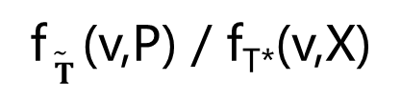


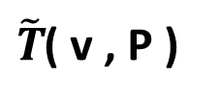

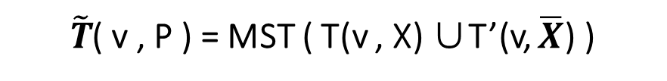

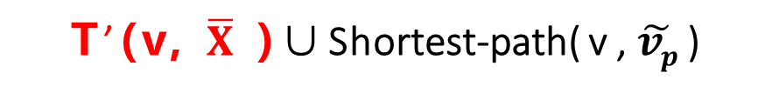


Priority Queue
a set D to maintain all the states
that have been computed
The Basic algorithm
$\tilde{T}$( v , P )
v1
v2
v3
v4
Preprocessing
a ) Edge growing operation
1
1
create a virtual node $\tilde{vp}$ , for a label p ∈ P ;
create an undirected edge( $\tilde{vp}$ , v ) with zero weight for each v ∈ V that includes a label p ;
compute the single-source shortest path from $\tilde{vp}$ to all the other nodes in the graph G.
b ) Tree merging operation
$$\overline{X}= P\backslash X$$
T(v,X )
T’(v, $\overline{X}$ )
4
4
4
4
4
4
approximation ratio
1
1
1
1
$\tilde{T}$( v , P ) = MST ( T(v , X) ∪T’(v, $\overline{X}$) )
f$\tilde{ T}$ (v,P) / f_{T*}(v,X)
T’(v, $\overline{X}$ )∪Shortest-path( v , $\tilde{vp}$ )
v1
v2
v3
v4
$\tilde{vp}$1
$\tilde{vp}$2
$\tilde{vp}$3
$\tilde{vp}$4
Notes:
使用 Dijkstra 方法求解 $\tilde{vp}$ 到其它 V 结点的最短路径
T’ ( v , $\overline{X}$) 将v 到$\overline{X}$ 虚拟结点的最短路径进行合并构成一棵树
然后将 T(v, X)与 T’ ( v , $\overline{X}$) 进行合并形成的最小生成树（MST）
这样获得一个可行解
当我们再进行 边添加 子树合并时就要进行 增长之后的 权重和是否小于 Best的权重，如果大于就舍弃不再进行操作
注意我们会用一个 D 来保存已经求得的状态的最优
注意合并时 X 与X- 不能有交集

Slide 31
The PrunedDP algorithm
u
Optimal-Tree Decomposition Theorem
Recall that in the Basic algorithm
To obtain the optimal solution f∗(P) for a query P , the algorithm must compute the optimal weights of all the intermediate states that are smaller than sub-optimal solutions .
For T*(P ) always exists a node u ∈ T* (P) :
the T*(P ) rooted at u has k (k ≥ 1) subtrees T1 , T2 , …Tk;
each subtree Ti has a weight smaller than f∗ (P) / 2 .
v1
v2
……
vk
T1
T2
T3
compute all the optimal subtrees that have weights smaller than f*(P )/2
merge the results obtained from the first stage to get the optimal tree.
Notes:
Assume that each edge in the graph G has a positive weight.
定理

Slide 32
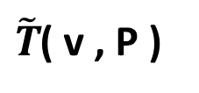
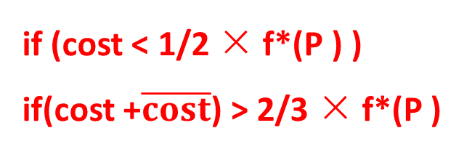
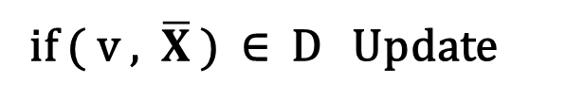
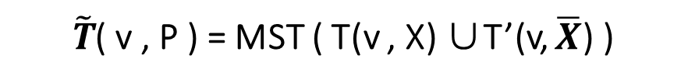
The PrunedDP algorithm
Priority Queue
{ a set D }
$\tilde{T}$( v , P )
Conditional Merging Theorem
v1
v2
v3
v4
merge two subtrees T (v, X ) and T (v, X’ ) for X’⊂ P \X only when
the total weight of these two subtrees is no larger than 2/3 × f*(P )
Optimal-Tree Decomposition Theorem
if (cost < 1/2 × f*(P ) )
if(cost +$\overline{cost}$) > 2/3 × f*(P )
if ( v , $\overline{X}$ ) ∈ D Update
$\tilde{T}$( v , P ) = MST ( T(v , X) ∪T’(v, $\overline{X}$) )
Notes:
这个定理我估计作者是偶然猜测出来的，证明很马虎。。。。。cry...s
大于 2/3 f*（P）的状态不需要树合并操作来进行
通过两个定理来减少了中间状态的求解次数 ，注意是 减少了求解次数

Slide 33





The PrunedDP++ algorithm
A* -search strategy
Heuristics
$$f\left(n\right)=g\left(n\right)+h(n)$$
Breadth-First-Search
A*-search strategy
Differences between PrunedDP++ and PrunedDP ：
The priority in the Priority Queue
in the update procedure, PrunedDP++ needs to invoke the lb procedure
Priority Queue
$$f∗\left(v,X\right)$$
$$+$$
$$lb$$
approximation ratio
f$\tilde{ T}$ (v,P) / $lb$
Notes:
首先对比一下搜索效果
A* 是一种用于寻找最短路径的搜寻策略
PrunedDP++方法与 PrunedDP方法在计算的流程上是极为相似的，区别在于在优先队列中的优先值计算时发生了一点点改变
由之前的比较每个状态自身的权重值大小改为了自身权重值加了一个启发式估计的一个值

Slide 34
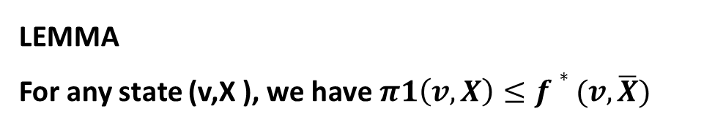

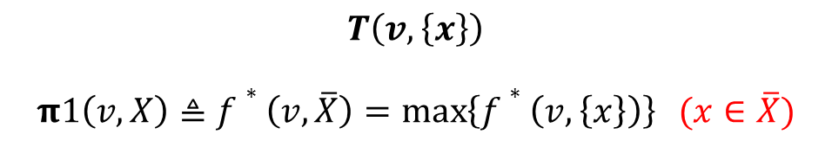



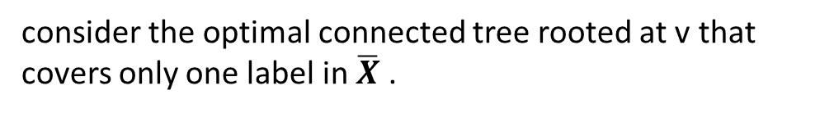
The Progressive A* Algorithm
One-label lower bound
$$T(v,\overline{X})$$
$$f\left(n\right)=g\left(n\right)+h(n)$$
consider the optimal connected tree rooted at v that covers only one label in $\overline{X}$ .
$$f\left(n\right)=g\left( v,X \right)+h(v,\overline{X})$$
$\overline{X}$ = P\X
$$T\left(v,\left\{x\right\}\right)$$
$$π1\left(v,X\right)≜f∗\left(v,\overline{X}\right)=\max\left\{f∗\left(v,\left\{x\right\}\right)\right\} (x∈\overline{X})$$
LEMMA
For any state (v,X ), we have$π1\left(v,X\right)≤f∗(v,\overline{X})$
Notes:
也就是说寻找（v,X-）的我们能肯定的最大的值

Slide 35
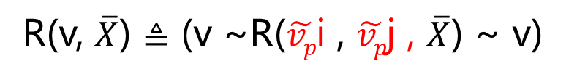

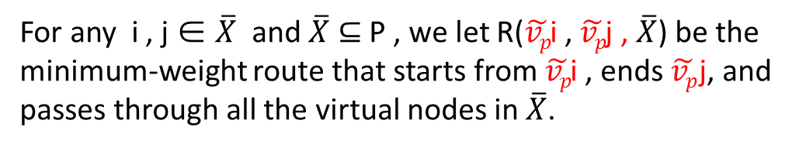


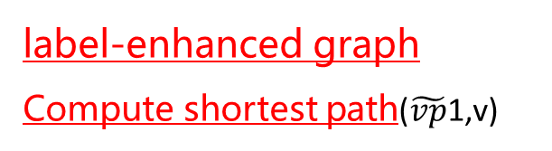




label-enhanced graph
Compute shortest path($\tilde{vp}$1,v)
The Progressive A* Algorithm
1
v9
1
v7
v8
Tour-based lower bound
4
4
4
$\tilde{vp}$i
4
4
4
For any i , j ∈ $\overline{X}$ and $\overline{X}$ ⊆ P , we let R($\tilde{vp}$i , $\tilde{vp}$j , $\overline{X}$) be the minimum-weight route that starts from $\tilde{vp}$i , ends $\tilde{vp}$j, and passes through all the virtual nodes in $\overline{X}$.
v5
v6
v
$$\overline{X}$$
1
1
1
1
v1
v2
$\tilde{vp}$j
v3
v4
R(v, $\overline{X}$) $≜$ (v ~R($\tilde{vp}$i , $\tilde{vp}$j , $\overline{X}$) ~ v)
Euler tour
$\tilde{vp}$1
$\tilde{vp}$2
$\tilde{vp}$3
$\tilde{vp}$4
$$π1\left(v,X\right)≜\min\left\{dist\left(v,\tilde{vp}i\right)+w\text{(}\tilde{vp}\text{i} \text{, }\tilde{vp}\text{j} \text{,} \overline{X}\text{)}+dist\left(v,\tilde{vp}j\right)\right\}/2 (i,j∈\overline{X})$$

Slide 36
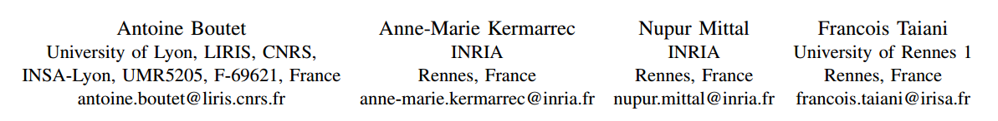
3. Being prepared in a sparse world : The case of KNN graph construction （ICDE-2016）

Slide 37
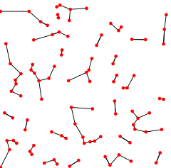
Preparation
K=1
KNN Graph (k nearest neighbor graph)
C
A
B
(e.g. Euclidean distance)
Notes:
In many discussions the directions of the edges are ignored and the NNG is defined as an ordinary (undirected) graph.
However, the nearest neighbor relation is not a symmetric one, i.e., p from the definition is not necessarily a nearest neighbor for q.
如果构建一个精确KNN图要 O(n²) 时间太长,所以我们选择构建一个 近似KNN图 （ Approximate-Nearest-Neighbor graph ）接下来我们讨论的就是如何创建一个ANN图

Slide 38
Preparation
Similarity Metric
Jaccard Coefficient
Tanimoto Coefficient
Pearson Coefficient
Euclidean Distance
Cosine
……
The ways to determine the similarity between two nodes.
Similarity = f_{sim} ( nodeA , nodeB )
f_{sim}( A , B ) > f_{sim}( A , C )
f_{sim}( B , A ) > f_{sim}( B , C )
f_{sim}( C , B ) > f_{sim}( C , A )
C
A
B
Notes:
If we can quantify different attributes of data objects, we can employ different similarity algorithms across those attributes that will yield similarity scores between the different data objects.

Slide 39
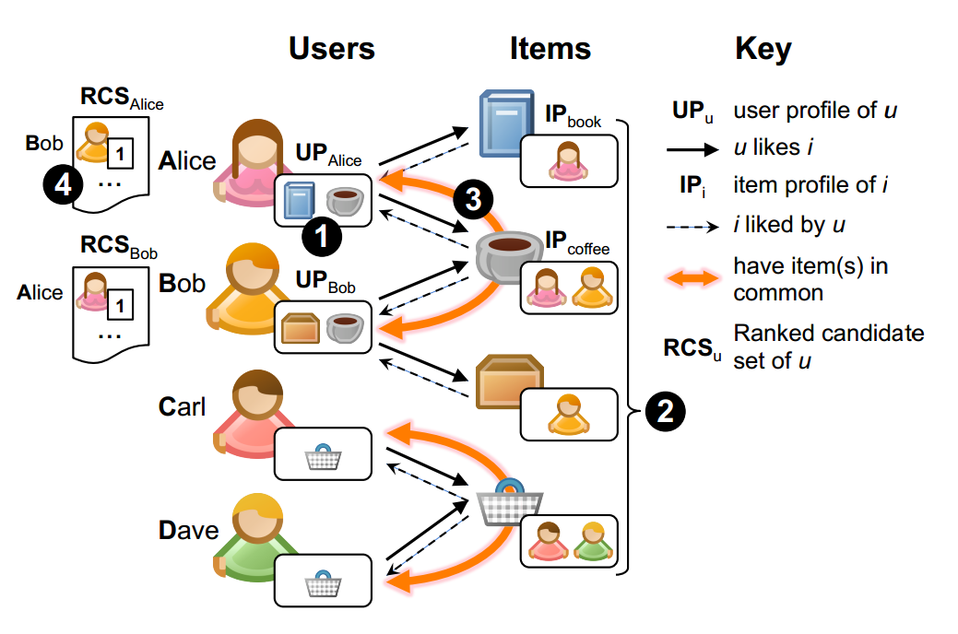
Problem definition
Our objective is to approximate a KNN graph.
ratings
item1
entity
book
item2
entity
……
coffee
Alice
ratings
f_{sim}( userA , userB )
Cosine
number of common items
Notes:
小型社交网络图
计算A和B之间的相似性由 共同爱好的个数以及相连的接的 ratings 值

Slide 40
Our solution
KIFF(K-nearest neighbor Impressively Fast and eFficient)
Counting Phase
builds a Ranked Candidate Set (RCS) for each user.
Item’s profile
IP_{book} = { Alice }
IP_{coffee} = { Alice , Bob }
User’s profile
UP_{Alice} = { book , coffee }
RCS_{Alice} = { ( Bob , 1 ) }
Notes:
使用多重集来存储 RCS
RCS are ordered weighted sets that bring together users who share items, while counting how many items these users have in common.

Slide 41
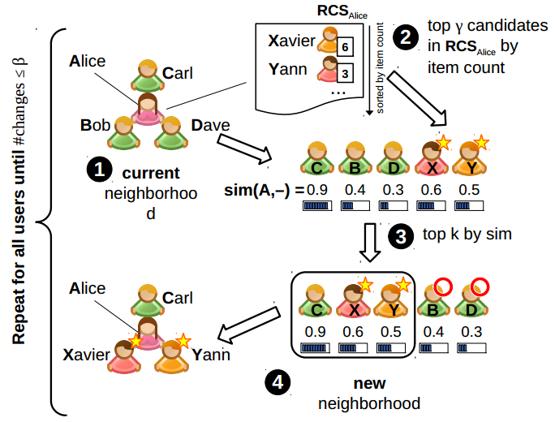




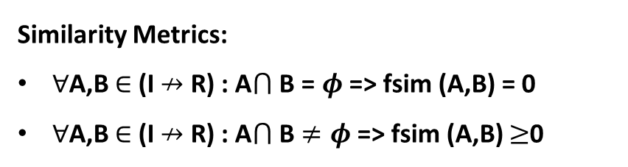

K = 3
Our solution
γ generally use 2k
Refinement Phase
注意：除了第一遍时为用户赋予初值，其他遍数时不再赋值。
再注：当用户执行了取 γ 元素之后，就为下一个元素执行 取 γ 元素的操作，不是一个用户一直 γ 取到changes 改变
RCS_{Alice} =
{(Bob,10),(Carl,9),(Dave,8) , (Xavier,6),(Yann,3),… }
$$\text{changes}$$
Xavier
Bob
Carl
Yann
Dave
Alice
Similarity Metrics:
$∀$A,B $∈$ (I $↛$ R) : A$⋂$ B = $φ$ => fsim (A,B) = 0
$∀$A,B $∈$ (I $↛$ R) : A$⋂$ B $≠φ$ => fsim (A,B) $≥$0
Bob
Carl
Dave
Xavier
Yann
Similarity
with Alice :
0.4
0.9
0.3
0.6
0.5
Notes:
任一集合任一空间
用一个最小堆（大小为 k ）来保存当前邻居

Slide 42
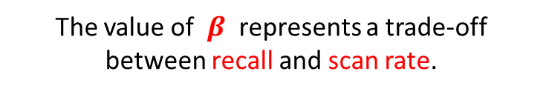
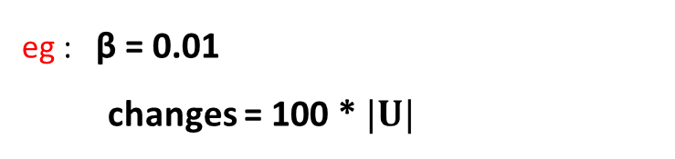

Our solution
Refinement Phase
$\frac{|U|}{\text{changes}}$ < β
eg : β = 0.01
changes = 100 * $|U|$
The value of $β$ represents a trade-off between recall and scan rate.
Notes:
$β$ 值的设定是平衡 准确率 和 scanrate 的取舍
The algorithm stops when the average number of changes per user during an iteration has dropped below a predefined threshold β.

Slide 43
Our solution
Optimization
RCS are heavily redundant ;
RCS_{Alice} = { ( Bob , 1 ) , …… }
RCS_{Bob} = { ( Alice, 1 ) , …… }
pivot strategy
Ela
Alice
Frank
Carl
Dave
Xavier
Yann
Alice
Bob
Similarity = f_{sim} ( Alice, Bob)

Slide 44
Our solution
Optimization
RCS are heavily redundant ;
simplify the initialization of neighborhoods at the start of the refinement phase ;

Slide 45
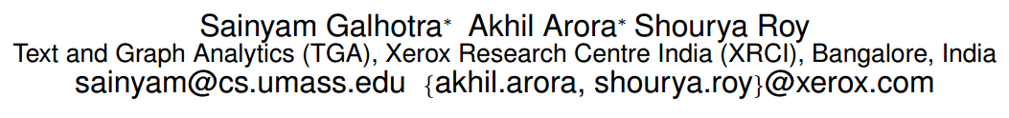
2. Combining Scalability and Efficiency with Opinion-Aware Models (SIGMOD-2016)
提出的一个新的影响力传播模型，涉及知识相对要很多，尤其是数学方面的知识

Slide 46
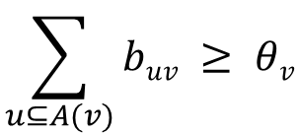
Influence Maximization
$$θB$$
Seed node
$$bBA$$
B
$$bBC$$
Active Node
A
C
$$\sum_{u⊆A(v)}{buv} ≥ θv$$
$$θA$$
$$bAD$$
$$bCD$$
$$θC$$
D
$$θD$$
Linear Threshold ( LT )
Independent Cascade ( IC )
Notes:
LT模型中 A(v) 代表 v 结点的入边
邻居 $θv$ 代表v结点的特异性阈值 b_{uv} 结点u对结点v 的影响大小
我们这里的 Spread 代表到程序截止时被种子结点激活的结点个数

Slide 47
Influence Maximization
Independent Cascade ( IC )
$$pBA$$
B
$$pBC$$
A
C
Spread
$$pAD$$
D
$$pCD$$
$$Γ\left(S\right)=V_{(a)}−|S|$$
Limitation of the notion of Spread and Model
Each node is considered to be contributing fully and positively towards the spread of information
A newly active node is always considered to perceive the information with the same intent as that of the node that activated it
Notes:
IC模型 p_{uv} 代表结点u可能激活结点v的概率
作者与实际生活的例子相结合，发现这样做并不符合真实的生活场景
每个结点都被认为是有利于信息传播的，而没有考虑每个结点自身的“意见”，也可能是消极的
每个新被激活的结点都被看成完全赞同激活它的结点的意图

Slide 48



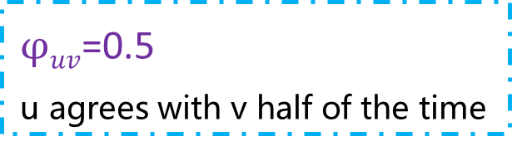

Opinion-cum-Interaction Model
O_{B}
$$pBA$$
B
$$pBC$$
OI serves as extension over the IC and LT
O_{C}
O_{A}
$$φBA$$
$$φBC$$
A
$$φAD$$
$$φCD$$
C
Opinion
$Ov$ $∈[−1,1]$
$$pAD$$
D
$$pCD$$
O_{D}
Interaction
$$φuv$$
$φuv$=0
v never agrees with u
$φuv$=0.5
u agrees with v half of the time
Opinion change
negative
neutral
positive
α = 0 with a probability of $φ_{(u,v)}$
α = 1 with a probability of $({1−φ}_{\left(u,v\right)})$
$$o_{A}^{′}=\frac{o_{A}+{(−1)}^{α}o_{B}}{2}$$
Notes:
作者提出OI模型的目的就是尽量模拟现实生活中传播的过程
用0~1之间的一个数来表示个人意见的强烈程度
O<0 O=0 O>0 分别代表反对 、中立 、支持
我们的 OI 模型这里介绍的是基于IC模型的
$φuv$ 代表 v 接受 u 的 opinion 的可能性(完全接受)

Slide 49

1. Cross-layer Betweenness Centrality in Multiplex Networks with Applications
ICDE-2016

Slide 50

Betweenness centrality
quantify the relative importance of a vertex
Informally
h
f
More formally
a
c
g
i
b
d
e
σ _{x,y} is the number of shortest paths between x and y
σ _{x,y} (v) is the number of shortest paths between x and y that pass through vertex v
Notes:
中介中心性：如果两个不相邻的参与者 k 和 j 想要与对方互动而参与者i处在它们的路径上，那么i可能对它们之间的互动拥有一定的控制力。中介性用来度量i对于其他结点的控制能力。即如果i处在非常多结点的交互路径上，那么i就是一个重要的参与者。
反映了节点v作为“桥梁”的重要程度

Slide 51
Multiplex networks
simple networks
a
c
h
f
b
a
c
g
i
b
d
e
a
c
b
the vertices are connected by a single interaction type or layer
Cross-layer Betweenness Centrality
Betweenness centrality

Slide 52
Exist solution
Approach 1
h
f
a
c
g
i
b
d
e
C(a) = C(b) = C(c)
h
f
a
c
g
i
b
d
e

Slide 53
Exist solution
Approach 2
h
f
a
c
g
i
b
d
e
$$+$$
h
f
C(a) = C(b) = C(c)
a
c
g
i
b
d
e

Slide 54


Our Solution
Layer 1
a
c
b
Layer 2
a
c
b

Slide 59
Thanks

